Slide 1
Global PSP Project for Indian Embassies and Consulates
Quick Guide – Print Passport Screen

Slide 2
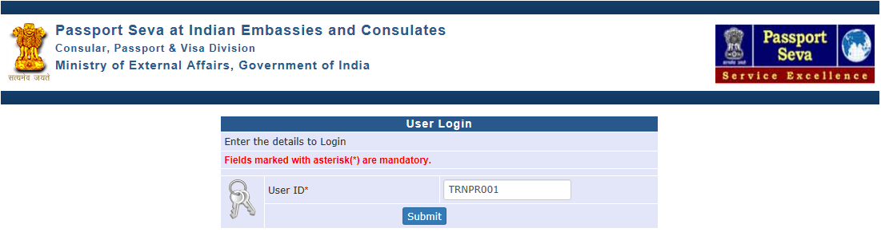
User Login
Visit Global PSP Office Portal (https://embassy.passportindia.gov.in)
Enter User ID
Press Submit button

Slide 3
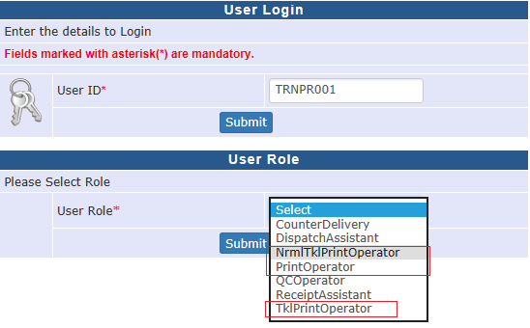
User Login (continued..)
Enter User Role as
a. PrintOperator (to print normal scheme passports only), OR
b. TklPrintOperator (to print tatkaal scheme passports only), OR
c. NrmlTklPrintOperator (to print both normal and tatkaal scheme passports)
Press Submit button displayed below User Role

Slide 4
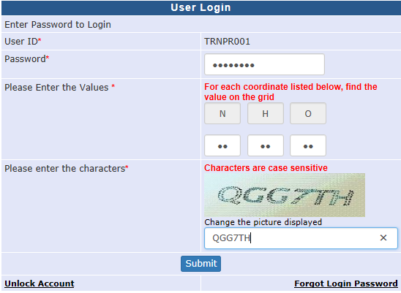
User Login (continued..)
Enter the Password
Check your User Grid and enter the values for the three alphabets displayed on the screen
Enter the characters displayed in the CAPTCHA image
Press Submit button

Slide 5
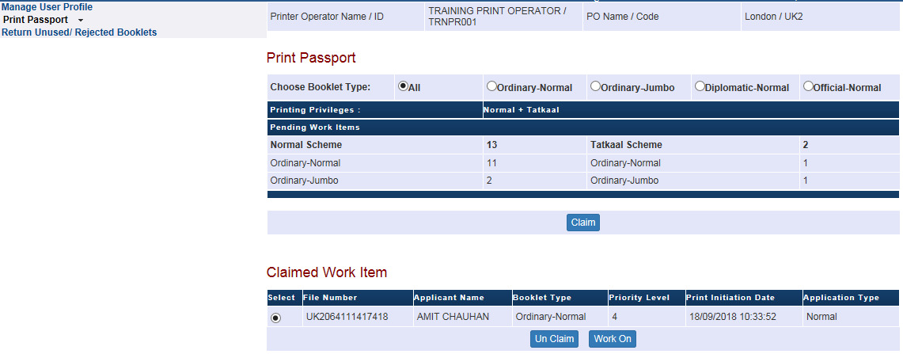
Print Passport screen
Click on the Print Passport link
Breakup of pending print jobs is displayed on screen. Press Claim button.
Next eligible pending print job is automatically identified and displayed as Claimed in Printer Operator’s worklist. Press Work On button to print the passport. Else, press Un Claim to move back the job to Pooled worklist.
Notes:
5

Slide 6
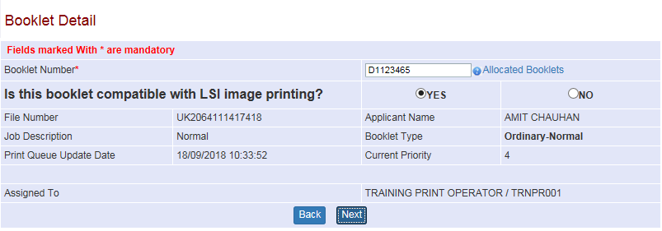
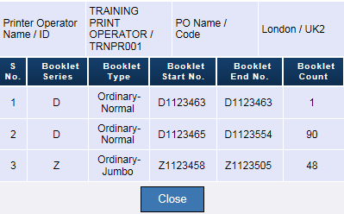
Print Passport (Continue..)
Enter Booklet Number on which passport is to be printed. (System will validate the same against the list of valid blank booklets assigned to the user (print operator)).
User can also recheck the booklets allocated to him/her by clicking on Allocated Booklet hyperlink. Press Next button to continue printing
Notes:
6

Slide 7
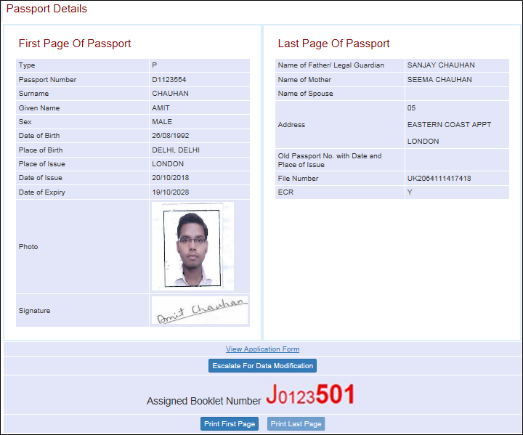
Print Passport (Continue..)
Check the Passport Preview and click on the Print First Page button
Notes:
7

Slide 8
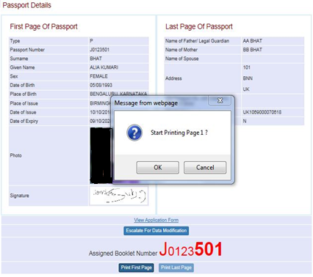
Print Passport (Continue..)
Start Printing Page 1 message appears on screen
Press OK button to print Page 1 of passport (after placing the booklet inside the printer device with Page 1 facing up)
Notes:
8

Slide 9
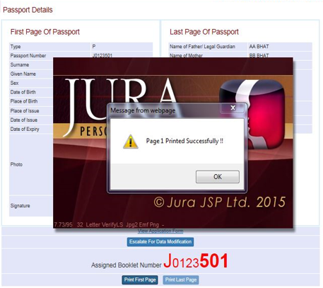
Print Passport (Continue..)
Page 1 Printed Successfully message appears on screen
Press OK button and click on Print Last Page button to print Page 2
Notes:
9

Slide 10
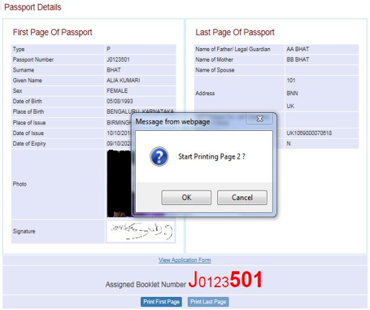
Print Passport (Continue..)
Start Printing Page 2 button is displayed
Press OK button to continue for printing the Page 2 of the passport (after placing the booklet inside the printer device with Page 2 facing up)
Notes:
10

Slide 11
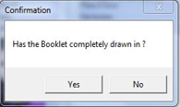
Print Passport (Continue..)
Intermittently – the Printer device may throw other confirmation messages like ‘Has the Booklet completely drawn in?”. Press Yes button when booklet is completely drawn in.
Notes:
11

Slide 12
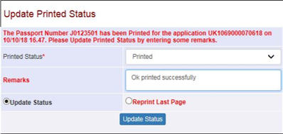
Print Passport (Continue..)
After completion of printing of Page 2 – the user is prompted to confirm the printing completion status in the “Update Printed Status”. The user may select the following options from the drop down list
a. Printed
b. Printed With Error (in case some details seem incorrectly printed)
Press “Update Status” button to initiate Passport QC process (physical passport to be sent to QC desk after lamination)
Else, press “Reprint Last Page” button just in case Page 2 was not actually printed (and user confirmed successful printing of page 2 earlier by mistake)
Notes:
12

Slide 13
In case of additional information or clarification, please contact Global PSP Support Team at
Email : global.psp@tcs.com
Phone : +91-0120-672-9595/96
Mobile : +91-730-351-9595
Thank You

